Slide 2
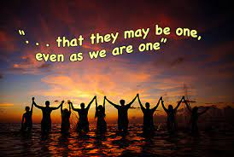

Slide 4
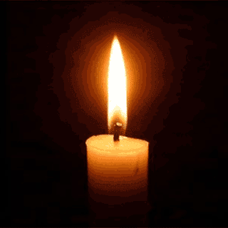
Lighting the Christ Candle

Slide 6
The Lord be with you
And Also With You

Slide 7
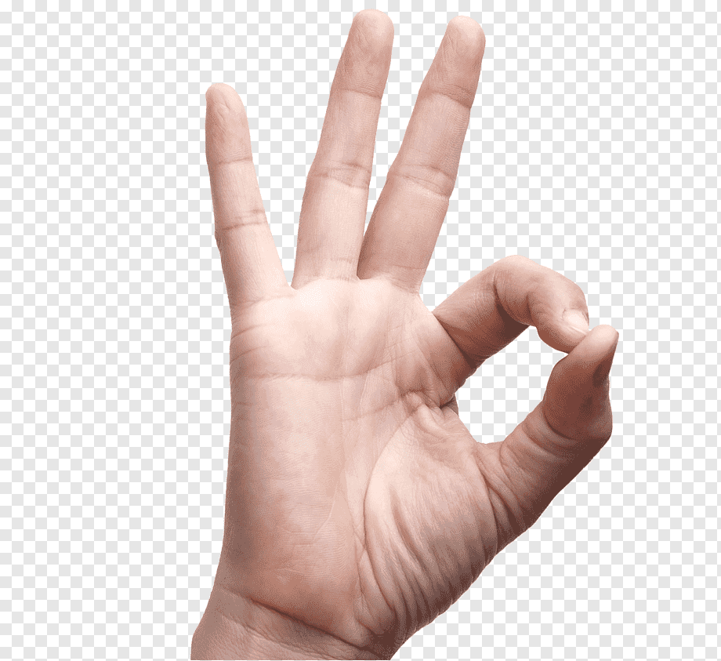
Sign of Peace

Slide 9
1 Blessed is the one who does not walk
in the counsel of the wicked or stand in the way of sinners or sit in the seat of mockers.
2 But their delight
is in the law of the LORD, and on this law
they meditate day and night.

Slide 10
3 They are like a tree
planted by streams of water, which yields its fruit in season and whose leaf does not wither. Whatever they do prospers.
4 Not so the wicked! They are like chaff that the wind blows away.

Slide 11
5 Therefore the wicked
will not stand in the judgment, nor sinners in
the assembly of the righteous
6 For the LORD watches
over the way of the righteous, but the way of the wicked
will perish.
Amen

Slide 13
Let earth and Heaven combine, Their voices all agree, To praise in songs divine The incarnate Deity, Our God contracted to a span, Incomprehensibly made Man.
1/4

Slide 14
Unsearchable the love That has the Saviour brought; The grace is far above Our own or angels’ thought: Enough for us that God, we know, Our God, is manifest below.
2/4

Slide 15
He deigns in flesh to appear, Widest extremes to join; To bring our vileness near, And make us all divine: And we the life of God shall know, For God is manifest below.
3/4

Slide 16
Made perfect first in love, And sanctified by grace, We shall from earth remove, And see His glorious face: Then shall His love be fully showed, And all shall all be lost in God.
4/4
Charles Wesley 1707-88

Slide 19
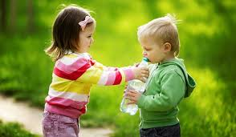

Slide 20
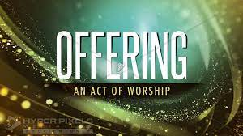

Slide 23
⁹ We accept human testimony, but God’s testimony
is greater because it is the testimony of God,
which he has given about his Son.
¹⁰ Whoever believes in the Son of God accepts this testimony. Whoever does not believe God has made him out to be a liar, because they have not believed the testimony God has given about his Son.
¹¹ And this is the testimony: God has given us eternal life, and this life is in his Son.

Slide 24
¹² Whoever has the Son has life;
whoever does not have the Son of God does not have life.
¹³ I write these things to you who believe in the name of the Son of God so that you may know that you have eternal life.

Slide 26
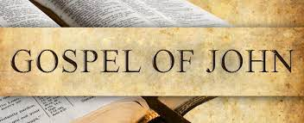

Slide 27
⁶ “I have revealed you to those whom you gave me out of the world. They were yours; you gave them to me and they have obeyed your word.
⁷ Now they know that everything you have given me comes from you.
⁸ For I gave them the words you gave me and they accepted them. They knew with certainty that I came from you, and they believed that you sent me.
⁹ I pray for them. I am not praying for the world,
but for those you have given me, for they are yours.

Slide 28
¹⁰ All I have is yours, and all you have is mine.
And glory has come to me through them.
¹¹ I will remain in the world no longer, but they are still in the world, and I am coming to you. Holy Father, protect them by the power of your name, the name you gave me, so that they may be one as we are one.
¹² While I was with them, I protected them and kept them safe by that name you gave me.
None has been lost except the one doomed to destruction so that Scripture would be fulfilled.

Slide 29
¹³ “I am coming to you now, but I say these things while I am still in the world, so that they may have
the full measure of my joy within them.
¹⁴ I have given them your word and the world has hated them, for they are not of the world any more than I am of the world.
¹⁵ My prayer is not that you take them out of the world but that you protect them from the evil one.
¹⁶ They are not of the world, even as I am not of it.

Slide 30
¹⁷ Sanctify them by the truth; your word is truth.
¹⁸ As you sent me into the world,
I have sent them into the world.
¹⁹ For them I sanctify myself, that they too may be truly sanctified.

Slide 32
Just as I am, without one plea,
But that thy blood was shed for me,
And that thou bidd'st me come to thee,
O Lamb of God, I come, I come.
1/6

Slide 33
Just as I am, though tossed about
With many a conflict, many a doubt;
Fighting’s and fears within, without,
O Lamb of God, I come, I come.
2/6

Slide 34
Just as I am, poor, wretched, blind;
Sight, riches, healing of the mind,
Yea, all I need, in thee to find,
O Lamb of God, I come, I come.
3/6

Slide 35
Just as I am, thou wilt receive;
Wilt welcome, pardon, cleanse, relieve,
Because thy promise I believe,
O Lamb of God, I come, I come.
4/6

Slide 36
Just as I am, thy love unknown
Has broken every barrier down;
Now to be thine, yea, thine alone,
O Lamb of God, I come, I come.
5/6

Slide 37
Just as I am, of that free love
The breadth, length, depth,
and height to prove,
Here for a season, then above:
O Lamb of God, I come, I come.
6/6
Words: Charlotte Elliott, 1841

Slide 39
⁶ “I have revealed, if you have seen me you have seen the Father, last week e had the I Am, Ø with Moses as Jesus is to us, you to those whom you gave, nothing outstanding about them, so we need not “measure up to them” until empowered by the Holy Spirit, me out of the world. They were yours; you gave them to me, and they have obeyed your word, Logos.
⁷ Now they know that everything you have given me comes from you.

Slide 40
⁸ For I gave them the words you gave me and they accepted them, but at this point in their journey, have they accepted them? At what point did we accept them? What difference did it make in our journey?. They knew with certainty that I came from you, and they believed that you sent me, as above, when did they accept?.
⁹ I PRAY FOR THEM. I am not praying for the world, Kosmos, but for those, people, you have given me, for they are yours.

Slide 41
¹⁰ All I have is yours, and all you have is mine, wonderful mutuality. And glory, a sense of pride, has come to me through them.
¹¹ I will remain in the world no longer, but they are still in the world, and I am coming to you. Holy Father, protect them by the power of your name, the name you gave me, so that they may be one as we are one. Let’s look at the ONENESS of the garage sale.

Slide 42
¹² While I was with them, I protected them and kept them safe by that name you gave me.
None has been lost except the one doomed to destruction so that Scripture would be fulfilled.
¹³ “I am coming to you now, but I say these things while I am still in the world, so that they may have the full measure of my joy within them.

Slide 43
¹⁴ I have given them your word, Logos, and the world kosmos, has hated them, for they are not of the, this, world any more than I am of the world.
¹⁵ My prayer is not that you take them out of the world but that you protect them from the evil one.

Slide 44
¹⁶ They are not of the world, even as I am not of it. ¹⁷ Sanctify them by the TRUTH; your word is TRUTH. ¹⁸ As you sent me into the world, I have sent them into the world. ¹⁹ For them I sanctify myself, that they too may be truly sanctified.

Slide 47
Our Father in heaven,
hallowed be Your name,
Your kingdom come,
Your will be done
On earth as in heaven.
Give us today our daily bread.

Slide 48
And forgive us our sins,
As we forgive those
who sin against us.
Save us from the time of trial,
And deliver us from evil.
For the kingdom, the power
and the glory are Yours,
Now and forever. Amen.

Slide 50
Crown Him with many crowns,
The Lamb upon His throne.
Hark! How the heavenly anthem drowns
All music but its own.
Awake, my soul, and sing
Of Him who died for me,
And hail Him as Your matchless King
Through all eternity.
1/6

Slide 51
Crown Him the Son of God,
Before the worlds began,
And we who tread where He has trod,
Crown Him the Son of Man;
Who every grief has known
That wrings the human breast,
And takes and bears them for His own,
That all in Him may rest.
2/6

Slide 52
Crown Him the Lord of love,
Behold His hands and side,
Those wounds, yet visible above,
In beauty glorified.
No angel in the sky
Can fully bear that sight,
But downward bends His burning eye
At mysteries so bright.
3/6

Slide 53
Crown Him the Lord of life,
Who triumphed over the grave,
And rose victorious in the strife
For those He came to save.
His glories now we sing,
Who died, and rose on high,
Who died eternal life to bring,
And lives that death may die.
4/6

Slide 54
Crown Him the Lord of peace,
Whose power a sceptre sways
From pole to pole, that wars may cease,
Absorbed in prayer and praise.
His reign shall know no end,
And round His pierced feet
Fair flowers of paradise extend
Their fragrance ever sweet.
5/6

Slide 55
Crown Him the Lord of years,
The Potentate of time,
Creator of the rolling spheres,
Majestic and sublime.
All hail, Redeemer, hail!
For You have died for me;
Your praise shall never never fail
Throughout eternity.
6/6
Words,1, 4-9: Matthew Bridges (1800-1894), 1852;
Godfrey Thring (1823-1903), 1874

Slide 57
Good Morning
and have a great week

